Slide 1

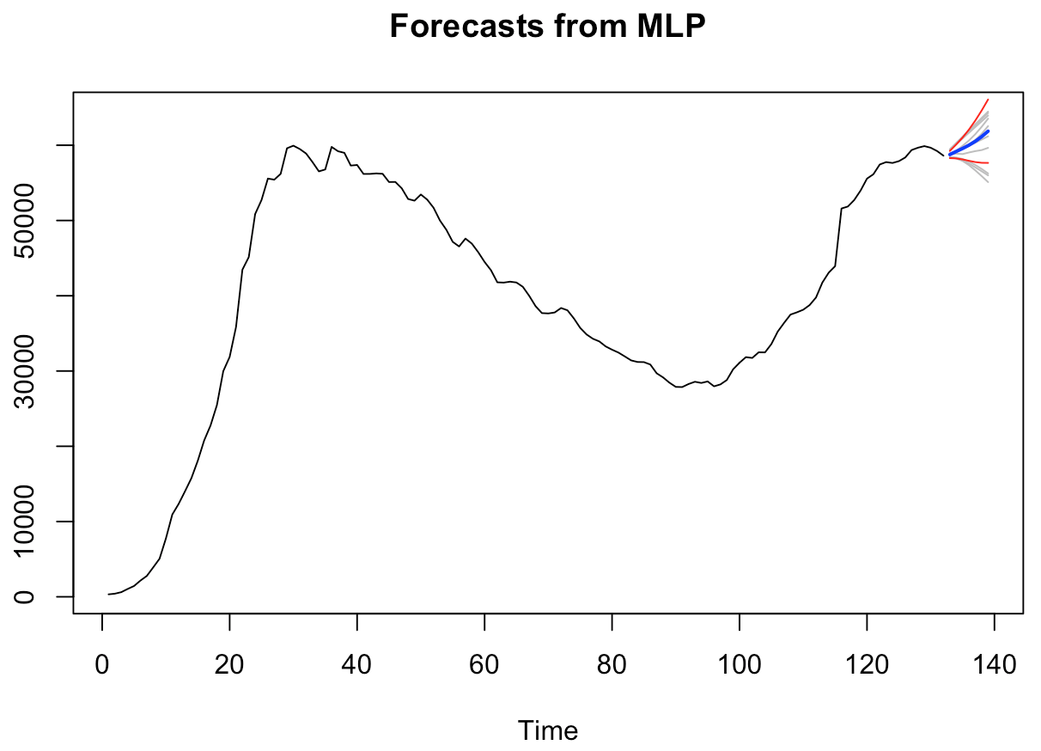
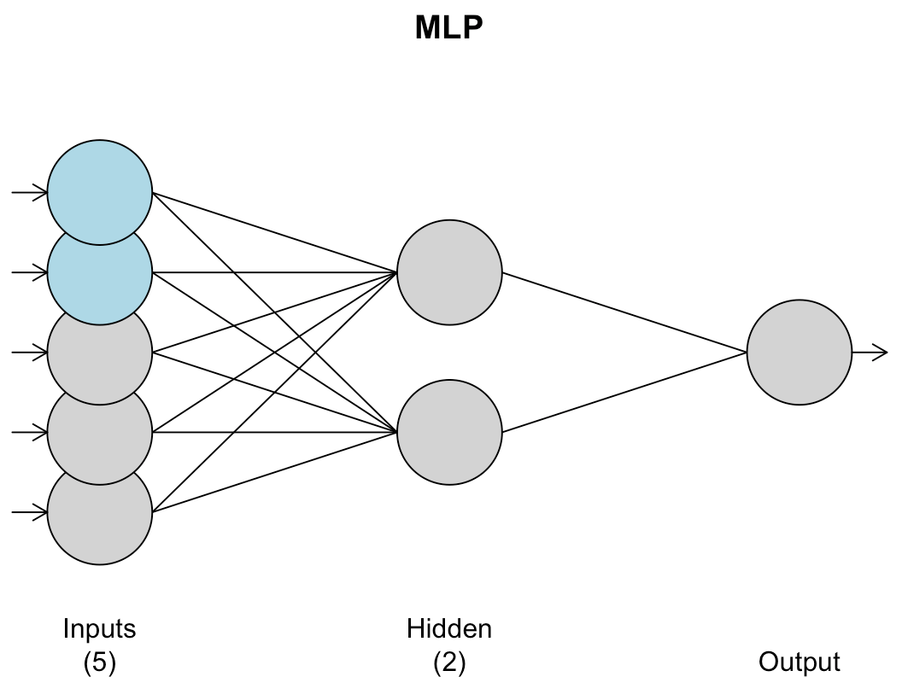
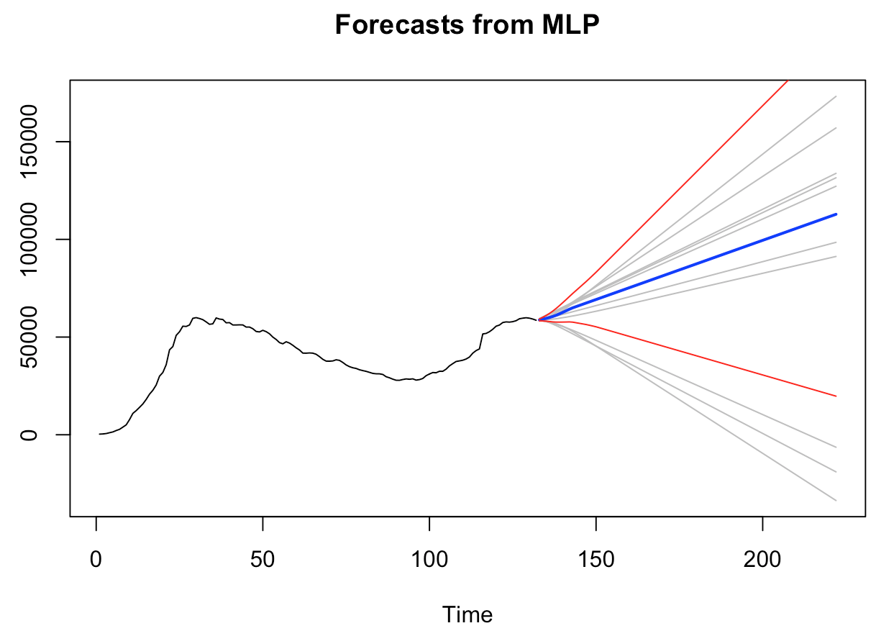

United states
Hyper parameter tuned MLP model
Notes:
Jaclyn
Time: 19 seconds
Lastly, we performed both a default parameter mlp and as an ensemble model, a hyper tuned parameter mlp. The mlp models are effective predictors because they take into account every possible forecasted outcome and create a mean of all of those forecasts for prediction. The hyper parameter tuned version is the favor model because it takes into account every best parameter as well.

